Slide 1

DMA Course Project(18ECSC301) 2020-21 Title 5DMACP17 Hostile Post Detection In Hindi
Team 4: Members *Varun Bohara 01fe18bcs278
*Madhurika G 01fe18bcs284
*Sakshi Tahlani 01fe18bcs271
*Abhishek Rao 01fe18bcs297

Slide 2
Introduction
Challenge is hosted on Codalab.
Proposed by SHARED TASK @CONSTRAINT 2021.
Important Dates:
October 1, 2020: Release of the training set and validation set.
December 1, 2020: Release of the test set.
December 10, 2020: Deadline for submitting the final results.
December 12, 2020: Announcement of the results.
December 30, 2020: System paper submission deadline.

Slide 3
Hostile Post Detection in Hindi
Our goal is to label a variety of posts in Hindi Devanagari script collected from Twitter and Facebook.
The set of valid categories are fake news, hate speech, offensive, defamation, and non-hostile posts.
It is a multi-label multi-class classification problem where each post can belong to one or more of these hostile classes but the non-hostile posts cannot be grouped with any other class.
Definitions of the class labels:
Fake News: A claim or information that is verified to be not true.
Hate Speech: A post targeting a specific group of people based on their ethnicity, religious beliefs, geographical belonging, race, etc., with malicious intentions of spreading hate or encouraging violence.
Offensive: A post containing profanity, impolite, rude, or vulgar language to insult a targeted individual or group.
Defamation: A mis-information regarding an individual or group.
Non-hostile: A post without any hostility.

Slide 4
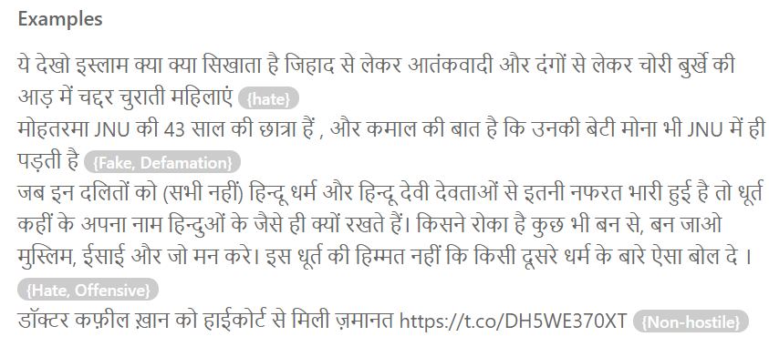

Slide 5
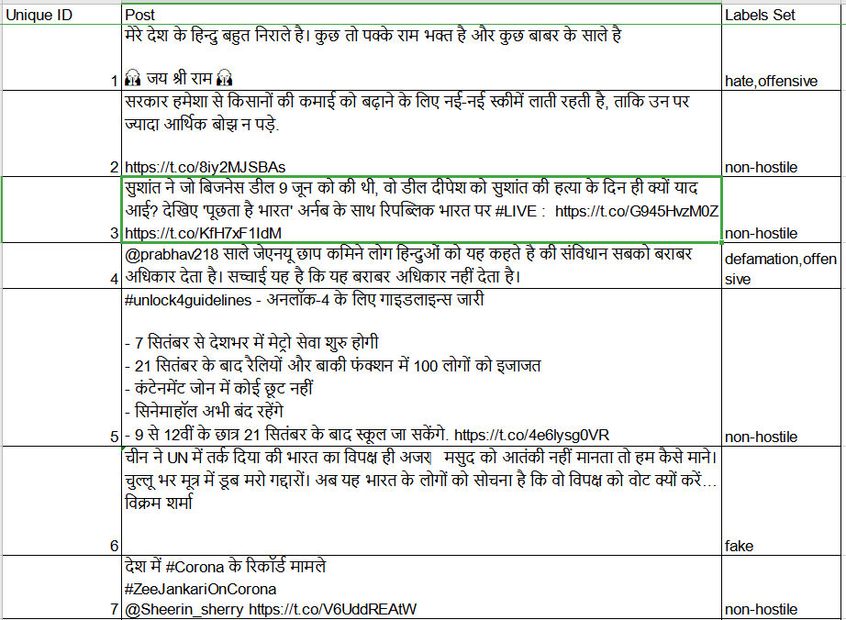
. Submission: A csv file in the following format for the final evaluation <unique_id, {labels}>
Data Set Description
Unique ID
Post
Labels Set
Constituents of Post:
Links
Special Characters - (@,/,:,#)
Alpha numerical
Emoji

Slide 6
Understanding of Data
Training Dataset : Constraint_Hindi_Train.xlsx Size : 5728 x 3 List Attributes : Unique Id,Post,Label Set Constituents of Post : Links ,Special Characters (@,/,:,#),Alpha numerical,Emoji. Format : Excel Validation Dataset: Constraint_Hindi_Train.xlsx Size : 811 x 3 List Attributes : Unique Id,Post,Label Set Constituents of Post : Links ,Special Characters (@,/,:,#),Alpha numerical,Emoji. Format : Excel

Slide 7
Data Interpretation

Slide 8
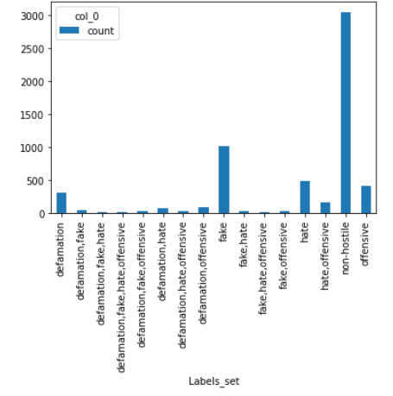
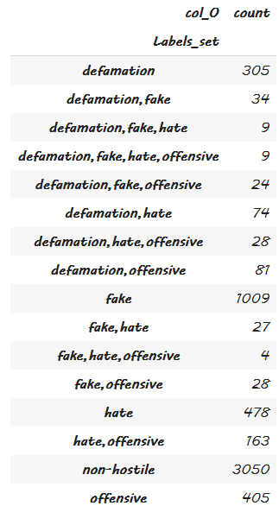
The above shown dataframe tells us that there are more number of single labelled data.
Even though this is a multi-label problem.

Slide 9
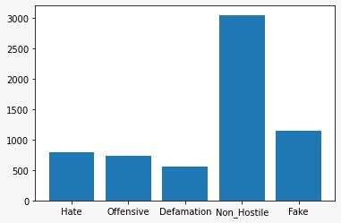
There's is a large class imbalance in the dataset interms of the labels.
This may lead to the model learning non hostile post more efficiently when compared to other.
This is called the Accuracy Paradox.
Frequency
Labels

Slide 10
References
Methods for Hindi-English Code-Mixed Data https://www.aclweb.org/anthology/2020.trac-1.7.pdf
Aggression-annotated Corpus of Hindi-English Code-mixed Data Ritesh Kumar, Aishwarya N. Reganti, Akshit Bhatia, Tushar Maheshwari https://arxiv.org/ftp/arxiv/papers/1803/1803.09402.pdf
Detecting Offensive Tweets in Hindi-English Code-Switched Language https://www.aclweb.org/anthology/W18-3504.pdf
Hindi2Vec Language Modeling https://github.com/NirantK/hindi2vec/blob/master/Hindi-Language-Modeling.ipynb

